Slide 1
Legal Services for
UNISON members
Henrietta Phillips
Thompsons Solicitors

Slide 2
Overview
Being a member of UNISON ensures you and your family have access to a comprehensive package of legal services provided by the UK’s leading firm for trade union members, Thompsons Solicitors.
Today, we will cover:
An introduction to Thompsons Solicitors
Which legal services are covered by your membership
How to access your legal service

Slide 3
Who are Thompsons Solicitors?
We are the UK’s largest trade union law firm
We were established in 1921 to act for working people and for trade unions and their members
We remain proudly part of the trade union movement today
We have 18 offices across England and Wales, with a Belfast office servicing members based in Northern Ireland and five offices across Scotland
We are the most experienced personal injury and employment rights practice in the UK

Slide 4



Who are Thompsons Solicitors?
We only act for injured or vulnerable people
We never act for insurance companies
We never act for employers
We manage very high-profile cases on behalf of unions
We represent members from all major trade unions

Slide 5
Why use Thompsons Solicitors?
Every year we secure over £200 million in personal injury compensation for our clients.
Change in legalisation means that high street firms and claims companies can now take up to 25% of compensation. With Thompsons, members receive 100% of their compensation
The person dealing with a member’s case will have experience of similar cases and will be a specialist in that area
We have a library of accident reports and investigations against common employers
We work with branch reps to identify witnesses, take pictures of accidents sites, provide information about whether accidents have occurred in the past, and generally support cases to get the best results
Notes:
Thompsons has specialist teams for:
ASBESTOS
Industrial Disease
Hand Arm Vibration Syndrome
Deafness
Upper Limb
Road Traffic Accidents
Clinical Negligence
Serious Injuries
Control of Substances Hazardous to Work
Holiday and foreign jurisdiction claims

Slide 6
Legal services for you
The following services are completely free
of charge:
Personal injuries or accidents, in and out of work
Industrial disease, including asbestos diseases
Employment rights
Settlement agreements
Work-related criminal law
Criminal injuries compensation
Basic wills
Legal advice
You also receive special terms for:
Clinical negligence
Conveyancing
Probate
Lasting powers of attorney
Deputyships

Slide 7
Legal services for your family
Family members are covered for:
All types of injury or accident which occurs outside of work, including:
  Personal injuries
  Serious injuries
  Road traffic accidents
  Accidents abroad
Family members also receive special terms for:
Clinical negligence
Wills
Conveyancing
Probate
Lasting powers of attorney
Deputyships

Slide 8
Compensation secured in 2023
£50,157,330 for UNISON members in England and Wales
£2,842,209 for UNISON members in Greater London Region

Slide 9
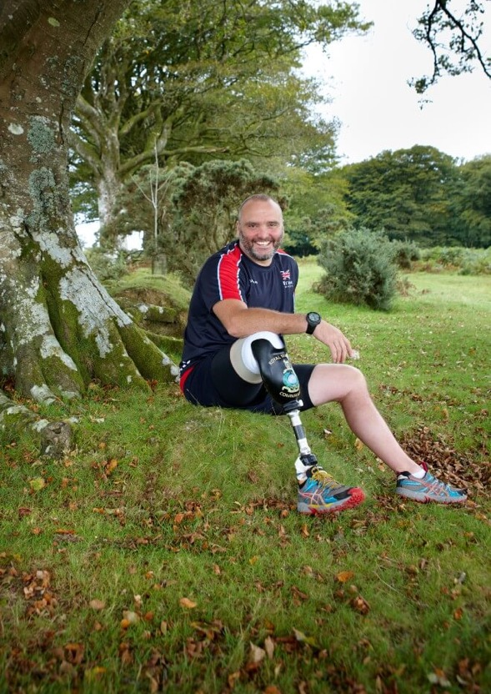
Personal injuries and accidents
Members are covered for any accident – at work, on the road or abroad
Members’ families are covered for any accident which happens outside of work
Road traffic accident client, Lee Spencer, who had his leg amputated after being hit by flying debris when the crashed car he was checking on was hit by another vehicle.

Slide 10

Industrial diseases
We have specialists with extensive experience of winning compensation for members who have suffered from:
Asbestos-related diseases
Hand-arm vibration syndrome (HAVS) or vibration white finger (VWF)
Work-related upper limb disorders (WRULD)
Work-related noise-induced hearing loss
Chemical injuries
Mesothelioma client, Pat Jolliffe, whose husband, Alan, died from mesothelioma after regular asbestos exposure during his career.

Slide 11
Clinical negligence
Thompsons’ clinical negligence team have handled some of the UK’s
most high-profile cases. Our expertise covers:
Cerebral palsy
Birth injuries
Cancer misdiagnosis (or missed diagnosis)
Undiagnosed fractures
Gynaecological and urology injuries, including mesh injuries
Surgical errors
“I’m very grateful for the advice and support provided by Thompsons.
“They were able to spell out for me, in simple terms, the legal situation and what I should expect as an outcome.”
UNISON member

Slide 12
Time limits
Type of claim | Time limit
Personal injuries | Three years from the date of your accident or injury developing
Industrial disease | Three years from the date of diagnosis OR three years from the date on which you became aware you had an illness which was your employer’s fault
Clinical negligence | Three years from the date of your injury OR three years from the date on which you could reasonably have become aware your injuries were caused by medical negligence
CICA | Two years from the date of the crime
Seek professional legal advice as soon as possible to ensure you the best chance of winning your case
There are very few exceptions to the above time limits

Slide 13
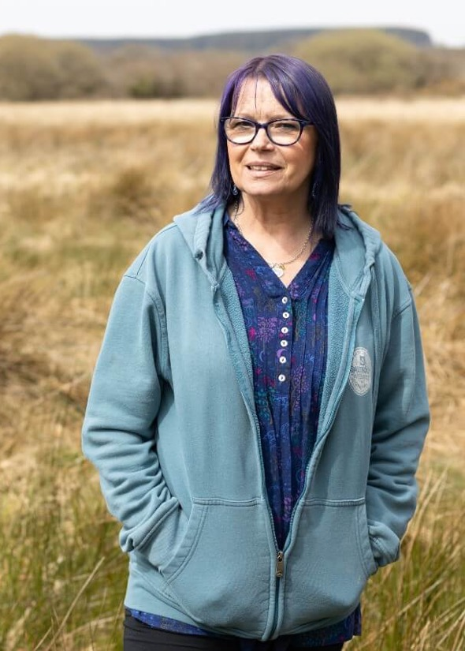
Employment rights
UNISON members receive free legal advice and representation for employment-related issues.
Employment rights advice is accessed through your branch
The aim is to save a member’s job, rather than to claim compensation after they’ve lost it
If a solution cannot be reached industrially, then a claim to the Employment Tribunal will be considered
Employment rights client, Carol King, who suffered sexism and harassment at work, to the point in which she resigned from her role as a paramedic.

Slide 14
Employment rights issues
Unfair dismissal claims
Settlement agreements
Redundancy and lay-off
Protective awards
Regulatory hearings
Discrimination claims
Contractual issues
Collective and industrial action
Working time issues and holidays
Pay and other benefits
TUPE
Settlement agreements
Notes:
Cover for work related employment issue for member.
Access to Thompsons is through the UNISON Regional Organiser.
Thompsons operate an advice line of the Regional Officer. They get telephone advice within 1 hour and written advice within 24 hours of their call.
Why do I have to go through the regional organiser?
Employment Law gives you minimum legal protection. Working with you branch and regional organiser you can negotiate an industrial resolution that can cover things no employment tribunal decision could.
It ensures consistency in how UNISON deal with industrial issues. It allows UNISON to deal with issues on behalf of members as a collective not just as an individual member.
It keeps a control on the cost of the employment service which has to be cross subsidised by UNISON.
It enables UNISON to identify trends in that workplace and across the country so UNISON to develop industrial strategies to campaign and bring about change for all.
UNISON and Thompsons operate an adviceline. The Regional Organiser can call for advice and will receive telephone advice within 1 hour and written advice within 24 hours.
Settlement Agreements
If a member opts to enter into a settlement agreement (to resolve an employment dispute) they will need to get legal advice
We have a specialist unit advising exclusively on settlement agreements
We offer a superior service to high street firms because we work in partnership with the union, have specialist knowledge of the trades and industries and our lawyers have a wealth of experience
We can provide our advice within 48 hours
We can provide a same day turnaround service for urgent matters
We will never charge members for the service
If the employer refuses to pay our standard fee (£350+vat) (it is always the employer who pays) the agreement should be referred to us anyway as we can negotiate on this
We can advise staff on a large scale (e.g. when a large redundancy is taking place) in any part of the country and at short notice.
The profit from this service goes into UNISON’s open book and allows UNISON to support other legal services. It is therefore imperative that member use UNISON for advice on settlement agreements.

Slide 15

Settlement agreements
Settlement agreements are legally binding contracts and deciding whether or not to accept their terms can be a daunting prospect
Getting expert advice during the settlement agreement process is a legal requirement
Our team of experts has helped thousands of people secure the best settlement agreements possible through a fast and efficient service
Notes:
Cover for work related employment issue for member.
Access to Thompsons is through the UNISON Regional Organiser.
Thompsons operate an advice line of the Regional Officer. They get telephone advice within 1 hour and written advice within 24 hours of their call.
Why do I have to go through the regional organiser?
Employment Law gives you minimum legal protection. Working with you branch and regional organiser you can negotiate an industrial resolution that can cover things no employment tribunal decision could.
It ensures consistency in how UNISON deal with industrial issues. It allows UNISON to deal with issues on behalf of members as a collective not just as an individual member.
It keeps a control on the cost of the employment service which has to be cross subsidised by UNISON.
It enables UNISON to identify trends in that workplace and across the country so UNISON to develop industrial strategies to campaign and bring about change for all.
UNISON and Thompsons operate an adviceline. The Regional Organiser can call for advice and will receive telephone advice within 1 hour and written advice within 24 hours.
Settlement Agreements
If a member opts to enter into a settlement agreement (to resolve an employment dispute) they will need to get legal advice
We have a specialist unit advising exclusively on settlement agreements
We offer a superior service to high street firms because we work in partnership with the union, have specialist knowledge of the trades and industries and our lawyers have a wealth of experience
We can provide our advice within 48 hours
We can provide a same day turnaround service for urgent matters
We will never charge members for the service
If the employer refuses to pay our standard fee (£350+vat) (it is always the employer who pays) the agreement should be referred to us anyway as we can negotiate on this
We can advise staff on a large scale (e.g. when a large redundancy is taking place) in any part of the country and at short notice.
The profit from this service goes into UNISON’s open book and allows UNISON to support other legal services. It is therefore imperative that member use UNISON for advice on settlement agreements.

Slide 16

Criminal law
We provide free initial advice and representation for any member with a work-related criminal case
The criminal team are specialists in work-related criminal cases and know how a criminal sanction can impact upon your employment or disclosure and barring
We provide a 24 hour a day, seven day a week service for police station advice and representation, and have successfully represented many UNISON members in a wide range of cases over many years
Notes:
The criminal law advice and representation scheme specifically excludes:
Drink driving offences
Road traffic offences - unless the member’s job is at risk
Assistance and representation for criminal proceedings where the member’s role is solely as a witness
Offences where the member is pleading guilty
If the member wants a solicitor on a private basis, Thompsons can represent privately.
Free initial advice and representation for any member with a work related criminal case.
The Criminal team are specialist who know how a criminal sanction can impact upon your employment. They can advise you on the impact accepting a caution might have on your employment.
Any allegation can also find its way on the disclosure and barring service.
May include representation at:
Police Station
Magistrates Court
Crown Court
Court of Appeal
Supreme Court
Thompsons provide a 24 hours a day, 7 days a week service for Police Station advice and representation and have successfully represented many UNISON members in a wide range of cases over many years.
How to contact
Legal Helpline: 0808 252 2783
UNISON Direct: 0800 0 857 857
UNISON 24 hour criminal helpline: 0800 587 7530
Police Station: Ask for Thompsons or UNISON’s Solicitors
UNISON CR form
Post Incident Procedure (Police Branches)
Post-incident investigations will commence in all situations following police contact that may have:
Resulted in death or serious injury
Revealed failings in command
Caused danger to officers or the public.
UNISON has a 24-hour PIP legal helpline: 0808 164 9332
Professional Regulation
Many UNISON members, especially those working in healthcare and social work, are in occupations that require them to register with statutory or voluntary registration bodies.
UNISON has a team of skilled representatives for this type of hearing based at head office.

Slide 17
Criminal law - access
Legal helpline: 0808 252 2783
UNISON Direct: 0800 0 857 857
UNISON 24 hour helpline: 0800 587 7530
Police station: Ask for Thompsons or UNISON’s solicitors
UNISON CR form
Notes:
How to contact
Legal Helpline: 0808 252 2783
UNISON Direct: 0800 0 857 857
UNISON 24 hour criminal helpline: 0800 587 7530
Police Station: Ask for Thompsons or UNISON’s Solicitors
UNISON CR form
Post Incident Procedure (Police Branches)
Post-incident investigations will commence in all situations following police contact that may have:
Resulted in death or serious injury
Revealed failings in command
Caused danger to officers or the public.
UNISON has a 24-hour PIP legal helpline: 0808 164 9332

Slide 18
Criminal law – post-incident procedure
Post-incident investigations will commence in all situations following police contact that may have:
  Resulted in death or serious injury
  Revealed failings in command
  Caused danger to officers or the public
UNISON has a 24-hour post-incident procedure legal helpline: 0808 164 9332

Slide 19
Professional regulation
Many UNISON members, especially those working in healthcare and social work, are in occupations that require them to register with statutory or voluntary registration bodies
Where there is a complaint about a member to a registration body, UNISON has a team of skilled representatives for this type of hearing based at head office

Slide 20

Criminal injury compensation
We provide free advice and representation for any members who are the victims of a criminal assault at work

Slide 21

Conveyancing, probate and powers of attorney
Fixed price and competitive conveyancing, probate and powers of attorney services are available to members
These services are provided by BBH (Legal Services) Limited, a firm owned by Thompsons Solicitors

Slide 22

Wills
The free wills service is available to all members
You can have a simple will prepared free of charge
More complex wills will be subject to a charge, but this will be lower than a high street solicitor
Notes:
Free basic wills services for members which is accessed online. In 2004, Thompsons drafted more wills than any other law firm in Europe.
UNISON membership enables you to have a will prepared free of charge and if you and your partner both want to make a will, again, this can be done at no cost. Just ring UNISON Direct to access this service. Family members are also entitled to low cost will drafting.

Slide 23

Free legal advice
Members are entitled to access a free legal advice service on any
non-employment related legal issue

Slide 24
Reminder of your legal scheme
Free of charge:
Personal injuries or accidents, in and out of work
Industrial disease, including asbestos diseases
Employment rights
Settlement agreements
Work-related criminal law
Criminal injuries compensation
Basic wills
Legal advice
Special terms:
Clinical negligence
Conveyancing
Probate
Lasting powers of attorney
Deputyships
Family members are covered for all types of personal injuries that occur outside of work.

Slide 25
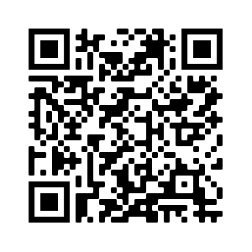
Free legal guides online
Members can access a range of legal guides and resources by scanning the below QR code:

Slide 26
How to get in touch
For personal injuries, industrial diseases and clinical negligence: www.thompsonstradeunion.law
0800 0 857 857 (UNISONDirect)
For conveyancing, probate, powers of attorney:
0800 051 4218
For wills: www.unison.org.uk
For employment rights: www.unison.org.uk or contact your local branch representative
1016.391

